Slide 1
Computer Graphics And Multimedia Applications SCS1302
Unit 3

Slide 2
3D object representation methods Polygon Surfaces, Polygon Tables
Boundary Representations (B-reps) − It describes a 3D object as a set of surfaces that separates the object interior from the environment.
Space–partitioning representations − It is used to describe interior properties, by partitioning the spatial region containing an object into a set of small, non-overlapping, contiguous solids (usually cubes).
Each vertex stores x, y, and z coordinate information which is represented in the table as v₁: x₁, y₁, z₁.
The Edge table is used to store the edge information of polygon. In the following figure, edge E₁ lies between vertex v₁ and v₂ which is represented in the table as E₁: v₁, v₂.
Polygon surface table stores the number of surfaces present in the polygon. From the following figure, surface S₁ is covered by edges E₁, E₂ and E₃ which can be represented in the polygon surface table as S₁: E₁, E₂, and E₃.

Slide 3
3 D object representation
3D object representation is divided into two categories.
Boundary Representations B− reps− It describes a 3D object as a set of surfaces that separates the object interior from the environment.
Space–partitioning representations − It is used to describe interior properties, by partitioning the spatial region containing an object into a set of small, non-overlapping, contiguous solids

Slide 4
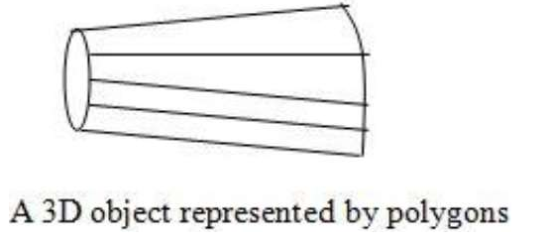
3 D object representation
The most commonly used boundary representation for a 3D graphics object is a set of surface polygons that enclose the object interior.

Slide 5
Polygon Tables
Vertex Table
Edge Table
Polygon Surface Table

Slide 6
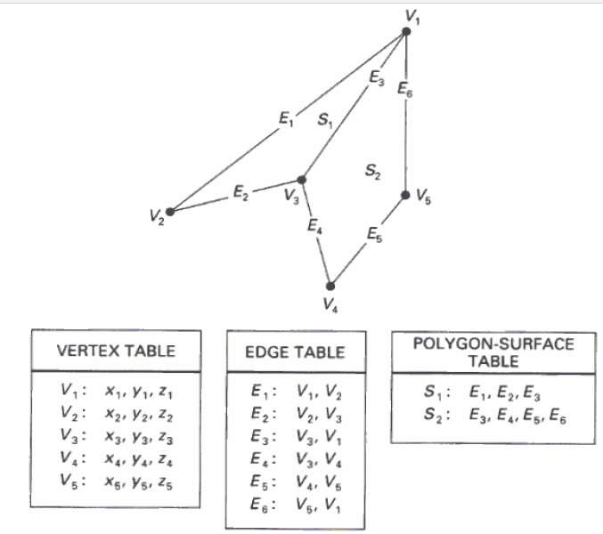
Polygon Tables

Slide 7
Plane Equations
The equation for plane surface can be expressed as −
Ax + By + Cz + D = 0
Where x,y,z is any point on the plane, and the coefficients A, B, C, and D are constants For any point x,y,z with parameters A, B, C, and D, we can say that −
Ax + By + Cz + D ≠ 0 means the point is not on the plane.
Ax + By + Cz + D < 0 means the point is inside the surface.
Ax + By + Cz + D > 0 means the point is outside the surface.

Slide 8
Polygon Meshes
3D surfaces and solids can be approximated by a set of polygonal and line elements. Such surfaces are called polygonal meshes.
In polygon mesh, each edge is shared by at most two polygons. The set of polygons or faces, together form the “skin” of the object.

Slide 9
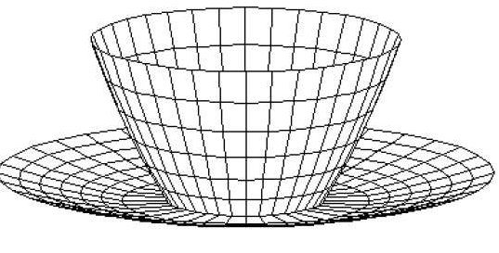
Polygon Meshes

Slide 10
Polygon Meshes
Advantages
It can be used to model almost any object.
They are easy to represent as a collection of vertices.
They are easy to transform.
They are easy to draw on computer screen.

Slide 11
Disadvantages
Curved surfaces can only be approximately described.
It is difficult to simulate some type of objects like hair or liquid.

Slide 12
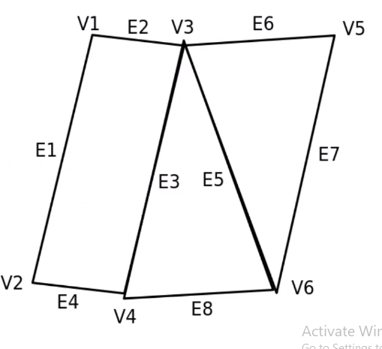
Example
S3
S1
S2

Slide 13
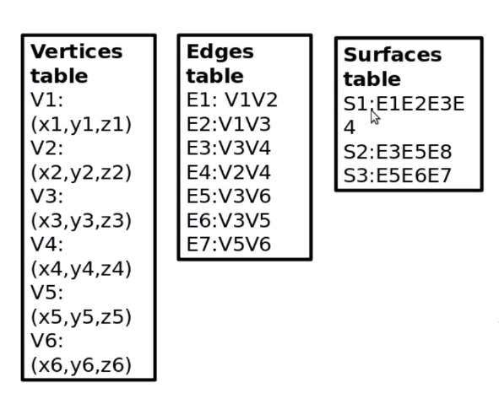

Slide 14
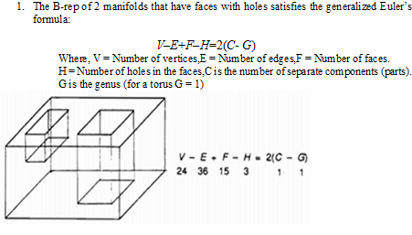
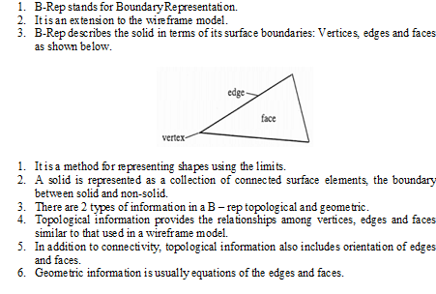
3D object representation methods
B-Rep:

Slide 15
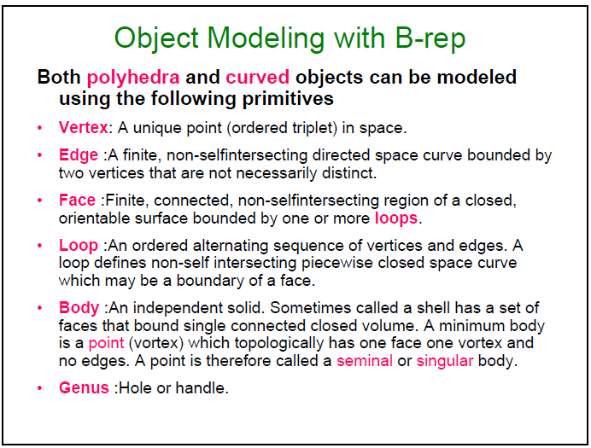

Slide 16
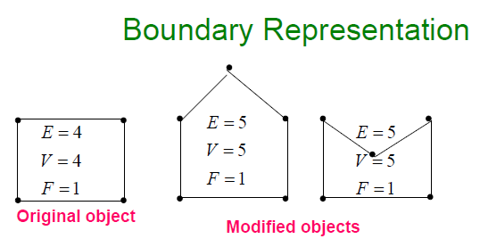

Slide 17
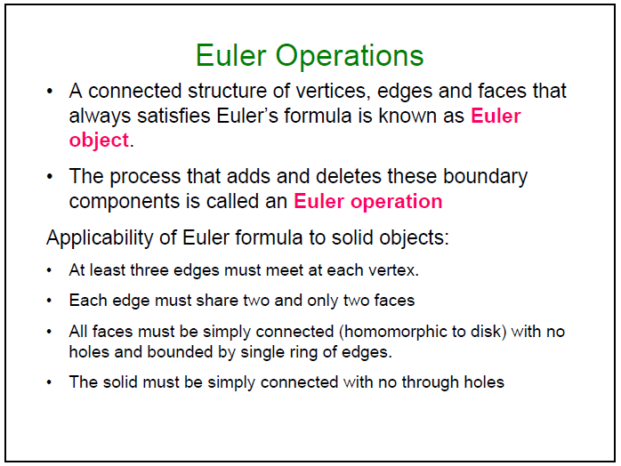

Slide 18
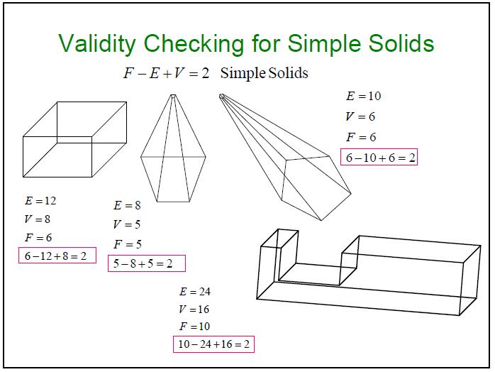

Slide 19
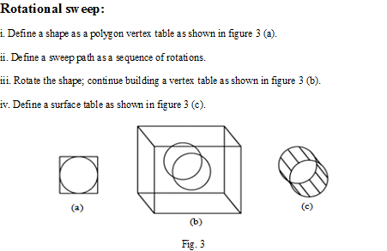
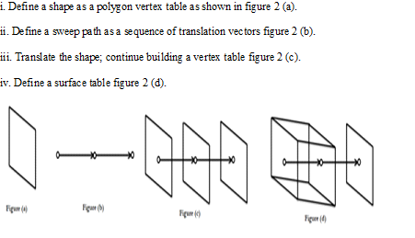
Sweep
Translational sweep:

Slide 20
SWEEP REPRESENTATIONS
https://www.youtube.com/watch?v=k_3lISNgkAo
https://www.youtube.com/watch?v=021P5-Vxl2o
http://www.dailyfreecode.com/code/creats-3d-solid-object-translational-654.aspx

Slide 21
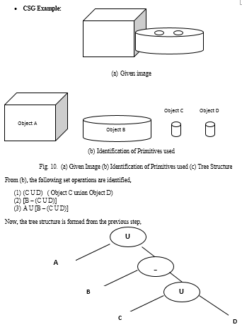
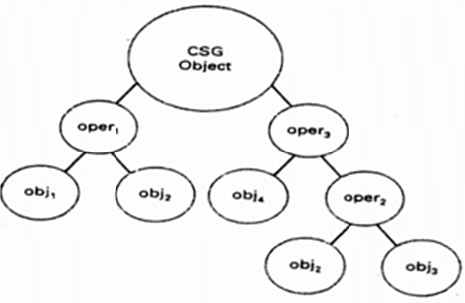
Sweep Representations: Sweep representations are used to construct 3D object from 2D shape that have some kind of symmetry.
CSG:
CSG stands for Constructive Solid Geometry.
It is based on set of 3D solid primitives and regularized set theoretic operations.
Traditional primitives are: Block, cones, sphere, cylinder and torus.
Operations: union, intersection, difference + translation and rotation.
A complex solid is represented using with a binary tree usually called as CSG tree.
CSG tree is shown below.

Slide 22
3D Transformations
Translation
Rotation
Reflection
Scaling
Shearing

Slide 23
Translation
3D Translation is a process of moving an object from one position to another in a three dimensional plane.

Slide 24
Translation
Let-
Initial coordinates of the object O = (X_{old}, Y_{old}, Z_{old})
New coordinates of the object O after translation = (X_{new}, Y_{new}, Z_{new})
Translation vector or Shift vector = (T_{x}, T_{y}, T_{z})
Given a Translation vector (T_{x}, T_{y}, T_{z})-
T_{x} defines the distance the X_{old} coordinate has to be moved.
T_{y} defines the distance the Y_{old} coordinate has to be moved.
T_{z} defines the distance the Z_{old} coordinate has to be moved.
This translation is achieved by adding the translation coordinates to the old coordinates of the object as-
X_{new} = X_{old} + T_{x} (This denotes translation towards X axis)
Y_{new} = Y_{old} + T_{y} (This denotes translation towards Y axis)
Z_{new} = Z_{old} + T_{z} (This denotes translation towards Z axis)

Slide 25
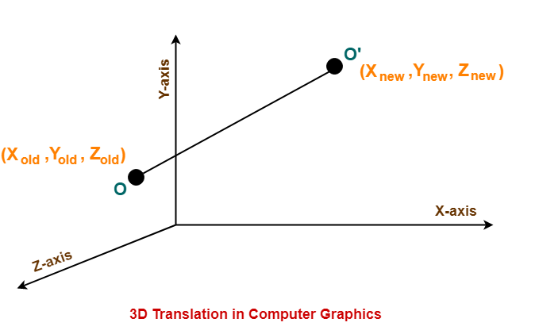
Translation

Slide 26
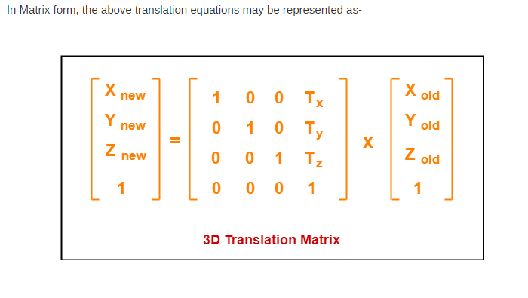
Translation

Slide 27
Example
Problem-
Given a 3D object with coordinate points A(0, 3, 1), B(3, 3, 2), C(3, 0, 0), D(0, 0, 0). Apply the translation with the distance 1 towards X axis, 1 towards Y axis and 2 towards Z axis and obtain the new coordinates of the object.

Slide 28
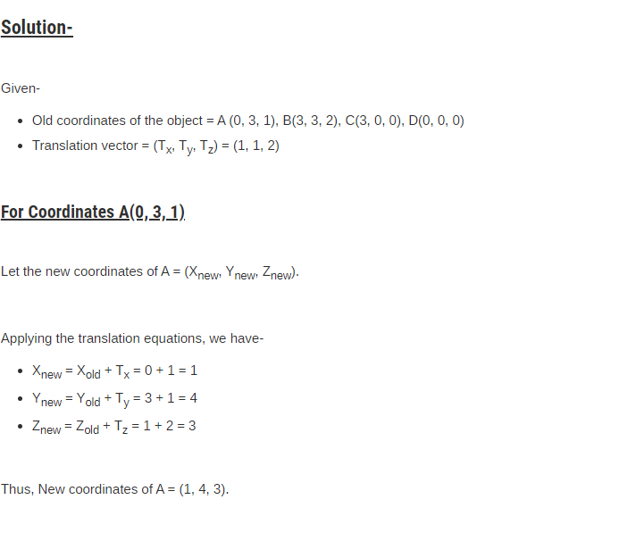
Example

Slide 29
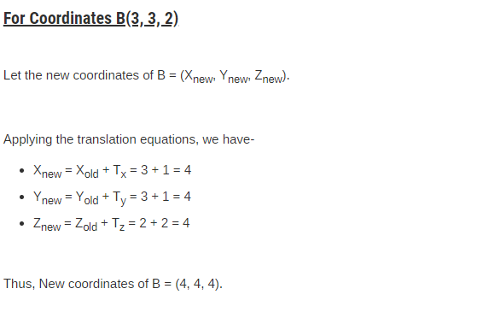
Example

Slide 30
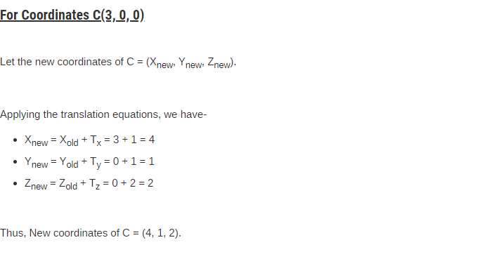
Example

Slide 31
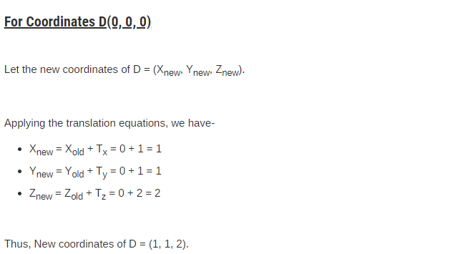
Example
Thus, New coordinates of the object = A (1, 4, 3), B(4, 4, 4), C(4, 1, 2), D(1, 1, 2).

Slide 32
Rotation
3D Rotation is a process of rotating an object with respect to an angle in a three dimensional plane.
Consider a point object O has to be rotated from one angle to another in a 3D plane.
Let-
Initial coordinates of the object O = (X_{old}, Y_{old}, Z_{old})
Initial angle of the object O with respect to origin = Φ
Rotation angle = θ
New coordinates of the object O after rotation = (X_{new}, Y_{new}, Z_{new})
In 3 dimensions, there are 3 possible types of rotation-
X-axis Rotation
Y-axis Rotation
Z-axis Rotation

Slide 33
For X-Axis Rotation-
This rotation is achieved by using the following rotation equations-
X_{new} = X_{old}
Y_{new} = Y_{old} x cosθ – Z_{old} x sinθ
Z_{new} = Y_{old} x sinθ + Z_{old} x cosθ
In Matrix form, the above rotation equations may be represented as-

Slide 34
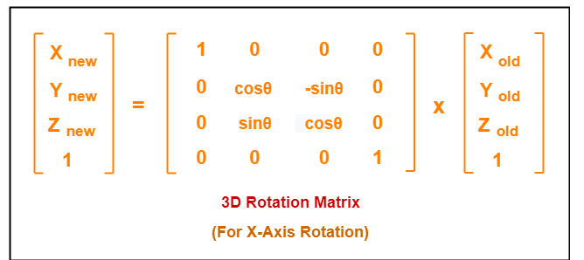

Slide 35
For Y-Axis Rotation-
This rotation is achieved by using the following rotation equations-
X_{new} = Z_{old} x sinθ + X_{old} x cosθ
Y_{new} = Y_{old}
Z_{new} = Y_{old} x cosθ – X_{old} x sinθ

Slide 36
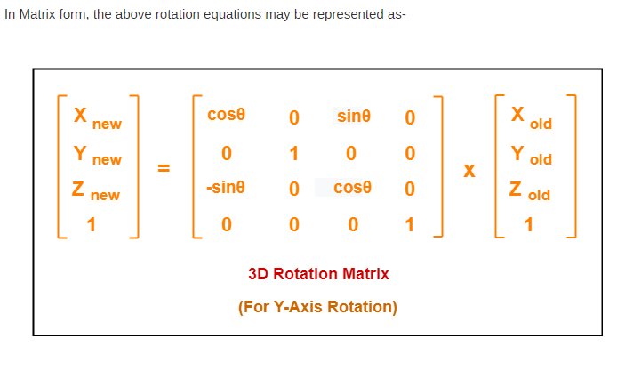

Slide 37
For Z-Axis Rotation-
This rotation is achieved by using the following rotation equations-
X_{new} = X_{old} x cosθ – Y_{old} x sinθ
Y_{new} = X_{old} x sinθ + Y_{old} x cosθ
Z_{new} = Z_{old}

Slide 38
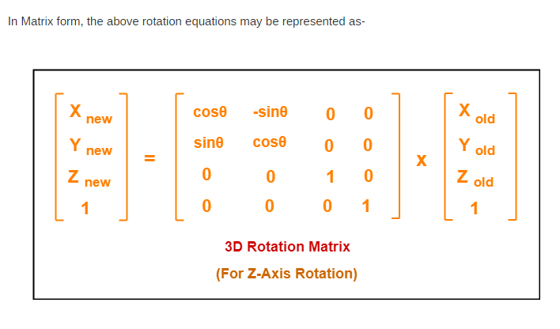

Slide 39
Example
Problem-01:
Given a homogeneous point (1, 2, 3). Apply rotation 90 degree towards X, Y and Z axis and find out the new coordinate points.
Solution-
Given-
Old coordinates = (X_{old}, Y_{old}, Z_{old}) = (1, 2, 3)
Rotation angle = θ = 90º

Slide 40
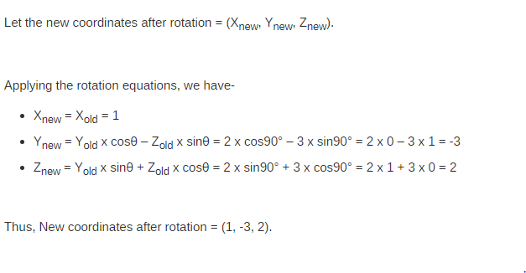
For X-Axis Rotation-

Slide 41
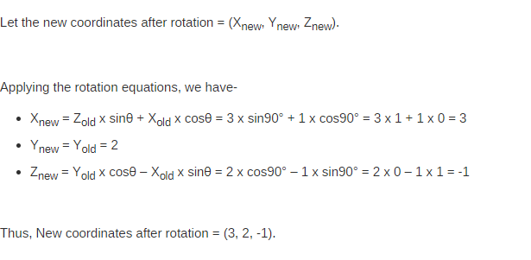
For Y-Axis Rotation-

Slide 42
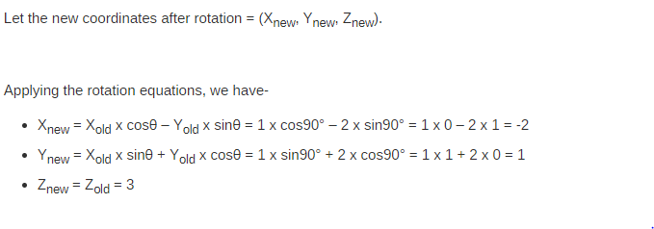
For Z-Axis Rotation-
Thus, New coordinates after rotation = (-2, 1, 3).

Slide 43
3D Scaling in Computer Graphics-
Scaling may be used to increase or reduce the size of object.
Scaling subjects the coordinate points of the original object to change.
Scaling factor determines whether the object size is to be increased or reduced.
If scaling factor > 1, then the object size is increased.
If scaling factor < 1, then the object size is reduced.

Slide 44
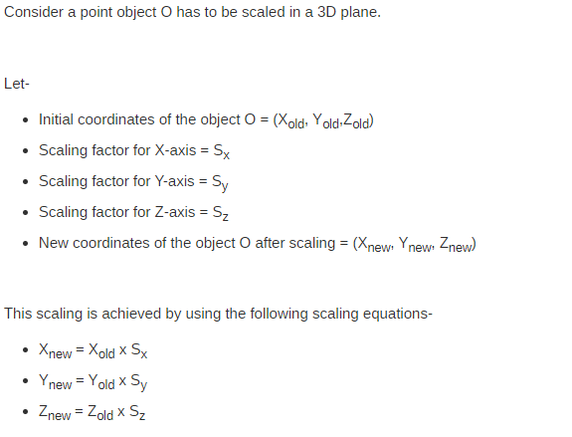
Scaling

Slide 45
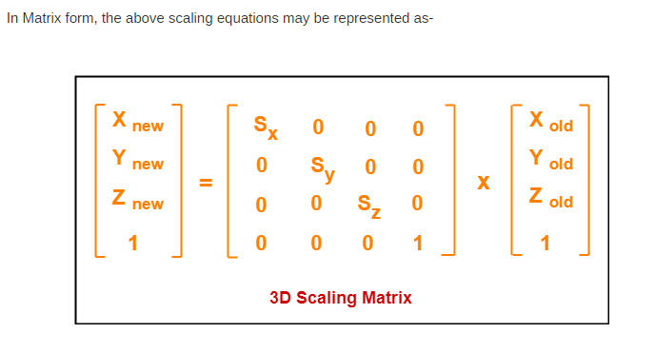
Scaling

Slide 46
Example
Problem-01:
Given a 3D object with coordinate points A(0, 3, 3), B(3, 3, 6), C(3, 0, 1), D(0, 0, 0). Apply the scaling parameter 2 towards X axis, 3 towards Y axis and 3 towards Z axis and obtain the new coordinates of the object.

Slide 47
Solution-
Given-
Old coordinates of the object = A (0, 3, 3), B(3, 3, 6), C(3, 0, 1), D(0, 0, 0)
Scaling factor along X axis = 2
Scaling factor along Y axis = 3
Scaling factor along Z axis = 3

Slide 48
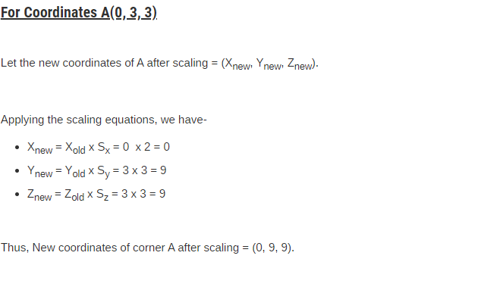
Solution-

Slide 49
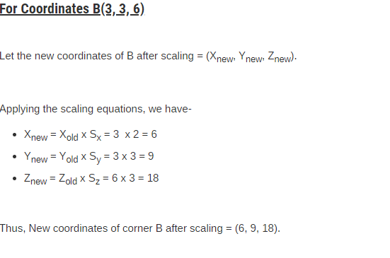
Solution-

Slide 50
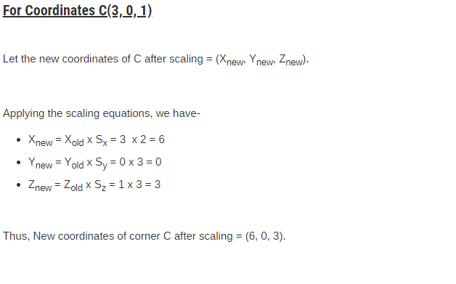
Solution-

Slide 51
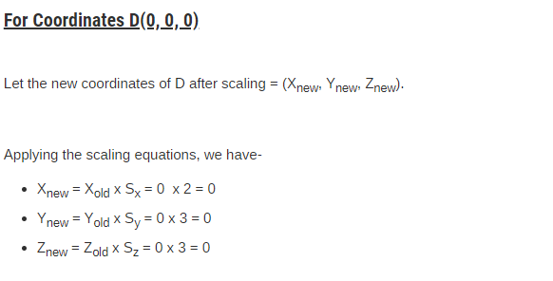
Solution-
Thus, New coordinates of corner D after scaling = (0, 0, 0).

Slide 52
3D Reflection
Reflection is a kind of rotation where the angle of rotation is 180 degree.
The reflected object is always formed on the other side of mirror.
The size of reflected object is same as the size of original object.

Slide 53
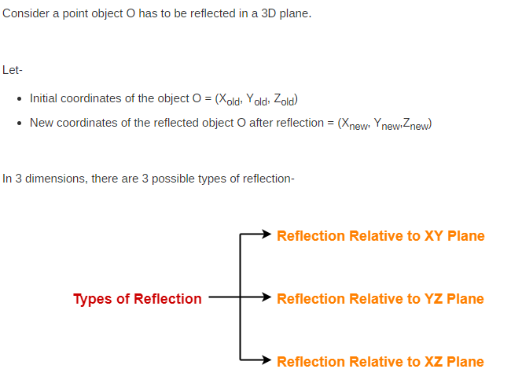
Reflection

Slide 54
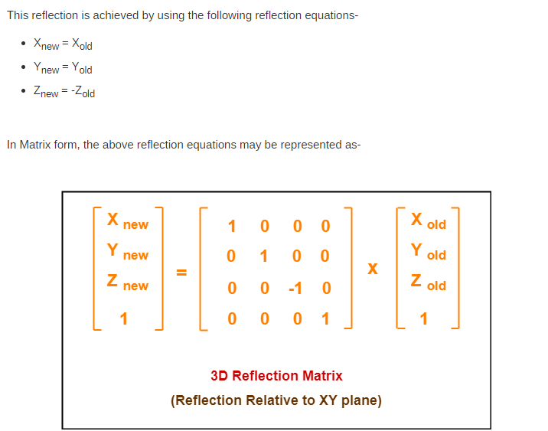
Reflection Relative to XY Plane:

Slide 55
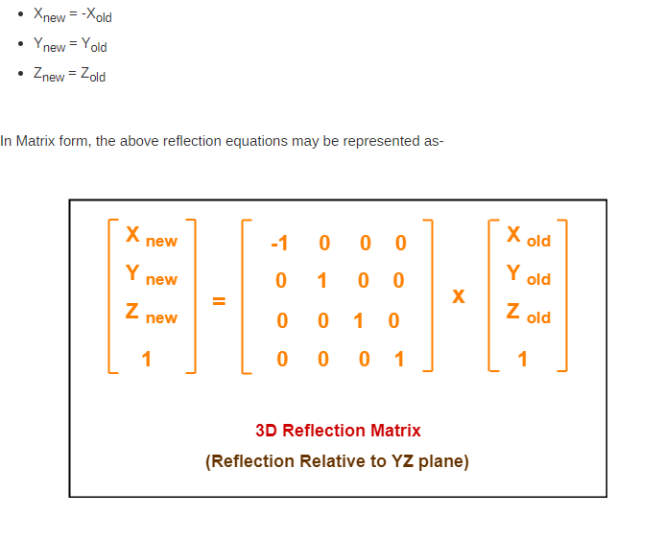
Reflection Relative to YZ Plane:

Slide 56
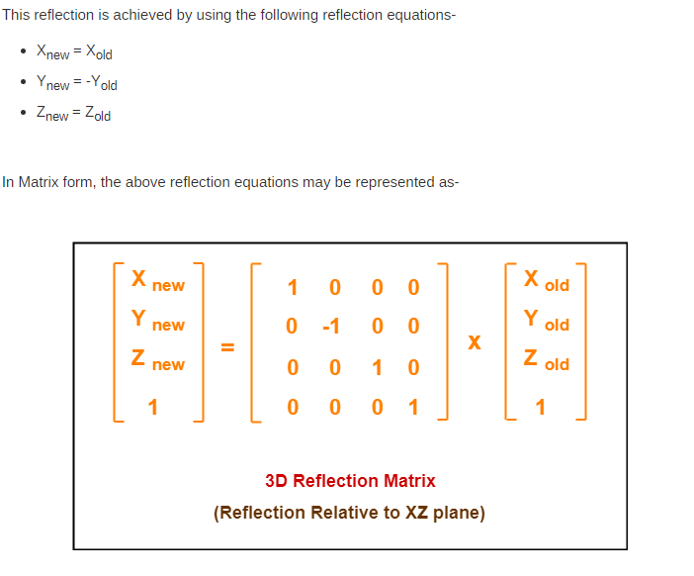
Reflection Relative to XZ Plane:

Slide 57
Example
Problem-01:
Given a 3D triangle with coordinate points A(3, 4, 1), B(6, 4, 2), C(5, 6, 3). Apply the reflection on the XY plane and find out the new coordinates of the object.
Solution-
Given-
Old corner coordinates of the triangle = A (3, 4, 1), B(6, 4, 2), C(5, 6, 3)
Reflection has to be taken on the XY plane

Slide 58
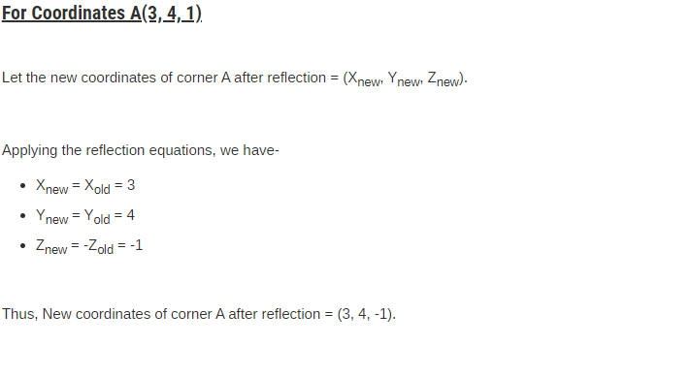
Solution

Slide 59

Solution

Slide 60
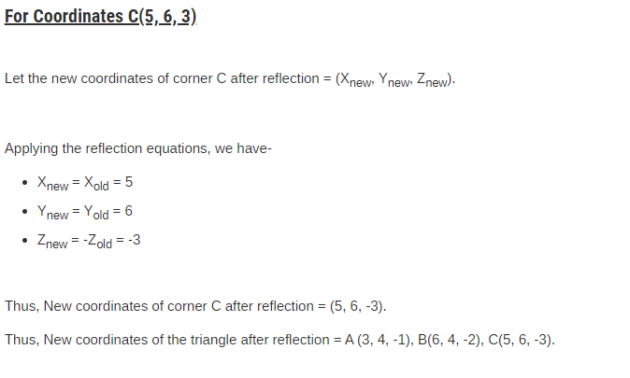
Solution

Slide 61
Shearing
In Computer graphics, 3D Shearing is an ideal technique to change the shape of an existing object in a three dimensional plane.

Slide 62
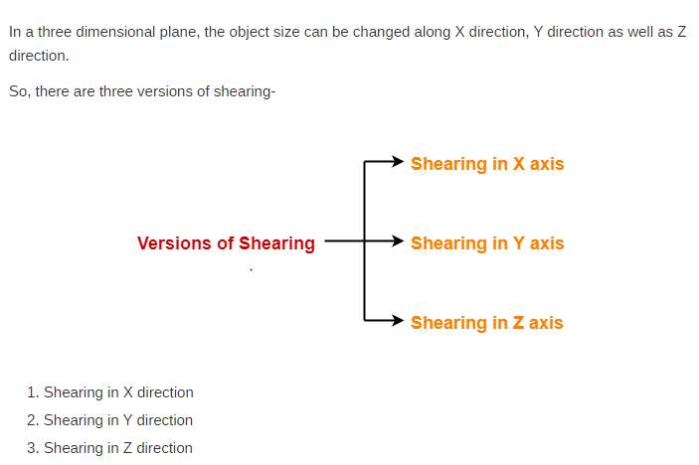
Shearing

Slide 63
Shearing in X axis
Consider a point object O has to be sheared in a 3D plane.
Let-
Initial coordinates of the object O = (X_{old}, Y_{old}, Z_{old})
Shearing parameter towards X direction = Sh_{x}
Shearing parameter towards Y direction = Sh_{y}
Shearing parameter towards Z direction = Sh_{z}
New coordinates of the object O after shearing = (X_{new}, Y_{new}, Z_{new})
Shearing in X Axis-
Shearing in X axis is achieved by using the following shearing equations-
X_{new} = X_{old}
Y_{new} = Y_{old} + Sh_{y} x X_{old}
Z_{new} = Z_{old} + Sh_{z} x X_{old}

Slide 64
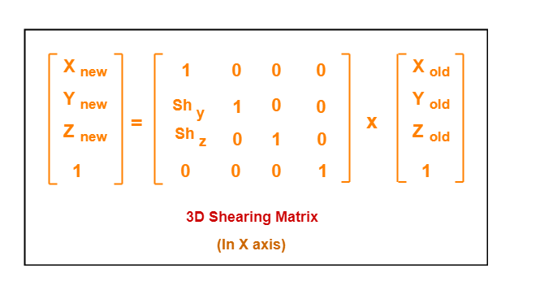

Slide 65
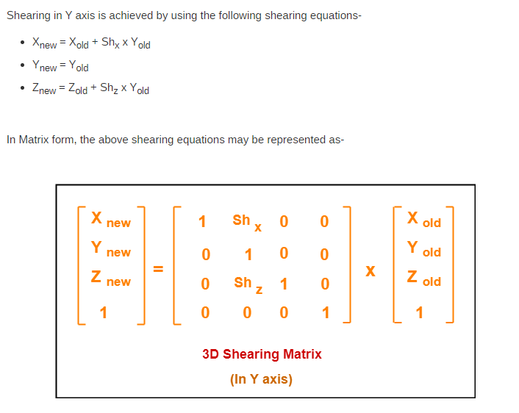
Shearing in Y Axis-

Slide 66
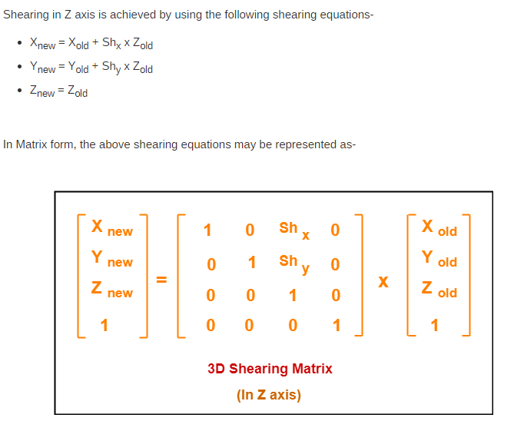
Shearing in Z Axis-

Slide 67
Example
Problem-01:
Given a 3D triangle with points (0, 0, 0), (1, 1, 2) and (1, 1, 3). Apply shear parameter 2 on X axis, 2 on Y axis and 3 on Z axis and find out the new coordinates of the object.
Solution-
Given-
Old corner coordinates of the triangle = A (0, 0, 0), B(1, 1, 2), C(1, 1, 3)
Shearing parameter towards X direction (Sh_{x}) = 2
Shearing parameter towards Y direction (Sh_{y}) = 2
Shearing parameter towards Y direction (Sh_{z}) = 3

Slide 68
Shearing in X Axis-
For Coordinates A(0, 0, 0)
Let the new coordinates of corner A after shearing = (X_{new}, Y_{new}, Z_{new}).
Applying the shearing equations, we have-
X_{new} = X_{old} = 0
Y_{new} = Y_{old} + Sh_{y} x X_{old} = 0 + 2 x 0 = 0
Z_{new} = Z_{old} + Sh_{z} x X_{old} = 0 + 3 x 0 = 0
Thus, New coordinates of corner A after shearing = (0, 0, 0).
For Coordinates B(1, 1, 2)
Let the new coordinates of corner B after shearing = (X_{new}, Y_{new}, Z_{new}).
Applying the shearing equations, we have-
X_{new} = X_{old} = 1
Y_{new} = Y_{old} + Sh_{y} x X_{old} = 1 + 2 x 1 = 3
Z_{new} = Z_{old} + Sh_{z} x X_{old} = 2 + 3 x 1 = 5
Thus, New coordinates of corner B after shearing = (1, 3, 5).

Slide 69
For Coordinates C(1, 1, 3)
Let the new coordinates of corner C after shearing = (X_{new}, Y_{new}, Z_{new}).
Applying the shearing equations, we have-
X_{new} = X_{old} = 1
Y_{new} = Y_{old} + Sh_{y} x X_{old} = 1 + 2 x 1 = 3
Z_{new} = Z_{old} + Sh_{z} x X_{old} = 3 + 3 x 1 = 6
Thus, New coordinates of corner C after shearing = (1, 3, 6).
Thus, New coordinates of the triangle after shearing in X axis = A (0, 0, 0), B(1, 3, 5), C(1, 3, 6).

Slide 70
Shearing in Y Axis-
For Coordinates A(0, 0, 0)
Let the new coordinates of corner A after shearing = (X_{new}, Y_{new}, Z_{new}).
Applying the shearing equations, we have-
X_{new} = X_{old} + Sh_{x} x Y_{old} = 0 + 2 x 0 = 0
Y_{new} = Y_{old} = 0
Z_{new} = Z_{old} + Sh_{z} x Y_{old} = 0 + 3 x 0 = 0
Thus, New coordinates of corner A after shearing = (0, 0, 0).
For Coordinates B(1, 1, 2)
Let the new coordinates of corner B after shearing = (X_{new}, Y_{new}, Z_{new}).
Applying the shearing equations, we have-
X_{new} = X_{old} + Sh_{x} x Y_{old} = 1 + 2 x 1 = 3
Y_{new} = Y_{old} = 1
Z_{new} = Z_{old} + Sh_{z} x Y_{old} = 2 + 3 x 1 = 5
Thus, New coordinates of corner B after shearing = (3, 1, 5).

Slide 71
For Coordinates C(1, 1, 3)
Let the new coordinates of corner C after shearing = (X_{new}, Y_{new}, Z_{new}).
Applying the shearing equations, we have-
X_{new} = X_{old} + Sh_{x} x Y_{old} = 1 + 2 x 1 = 3
Y_{new} = Y_{old} = 1
Z_{new} = Z_{old} + Sh_{z} x Y_{old} = 3 + 3 x 1 = 6
Thus, New coordinates of corner C after shearing = (3, 1, 6).
Thus, New coordinates of the triangle after shearing in Y axis = A (0, 0, 0), B(3, 1, 5), C(3, 1, 6).

Slide 72
Shearing in Z Axis-
For Coordinates A(0, 0, 0)
Let the new coordinates of corner A after shearing = (X_{new}, Y_{new}, Z_{new}).
Applying the shearing equations, we have-
X_{new} = X_{old} + Sh_{x} x Z_{old} = 0 + 2 x 0 = 0
Y_{new} = Y_{old} + Sh_{y} x Z_{old} = 0 + 2 x 0 = 0
Z_{new} = Z_{old} = 0
Thus, New coordinates of corner A after shearing = (0, 0, 0).
For Coordinates B(1, 1, 2)
Let the new coordinates of corner B after shearing = (X_{new}, Y_{new}, Z_{new}).
Applying the shearing equations, we have-
X_{new} = X_{old} + Sh_{x} x Z_{old} = 1 + 2 x 2 = 5
Y_{new} = Y_{old} + Sh_{y} x Z_{old} = 1 + 2 x 2 = 5
Z_{new} = Z_{old} = 2
Thus, New coordinates of corner B after shearing = (5, 5, 2).

Slide 73
For Coordinates C(1, 1, 3)
Let the new coordinates of corner C after shearing = (X_{new}, Y_{new}, Z_{new}).
Applying the shearing equations, we have-
X_{new} = X_{old} + Sh_{x} x Z_{old} = 1 + 2 x 3 = 7
Y_{new} = Y_{old} + Sh_{y} x Z_{old} = 1 + 2 x 3 = 7
Z_{new} = Z_{old} = 3
Thus, New coordinates of corner C after shearing = (7, 7, 3).

Slide 74
Curve generation - cubic splines, Beziers, blending of curves- other interpolation techniques
Types of Curves
A curve is an infinitely large set of points. Each point has two neighbors except endpoints. Curves can be broadly classified into three categories − explicit, implicit, and parametric curves.

Slide 75
Implicit Curves
Implicit curve representations define the set of points on a curve by employing a procedure that can test to see if a point in on the curve. Usually, an implicit curve is defined by an implicit function of the form −
f(x, y) = 0
It can represent multi valued curves (multiple y values for an x value). A common example is the circle, whose implicit representation is x2+y2-R2=0

Slide 76
Explicit Curves
Explicit Curves
A mathematical function y = f(x) can be plotted as a curve. Such a function is the explicit representation of the curve. The explicit representation is not general, since it cannot represent vertical lines and is also single-valued. For each value of x, only a single value of y is normally computed by the function.

Slide 77
Parametric Curves
Curves having parametric form are called parametric curves.
The explicit and implicit curve representations can be used only when the function is known. In practice the parametric curves are used. A two-dimensional parametric curve has the following form −
P(t) = f(t), g(t) or P(t) = x(t), y(t)
The functions f and g become the (x, y) coordinates of any point on the curve, and the points are obtained when the parameter t is varied over a certain interval [a, b], normally [0, 1].

Slide 78
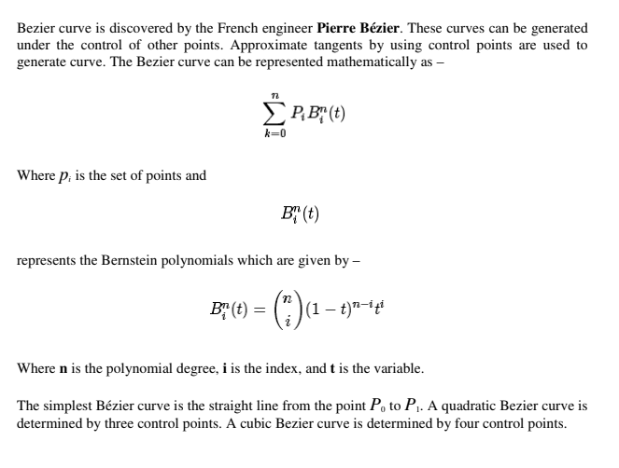
Bezier Curves

Slide 79
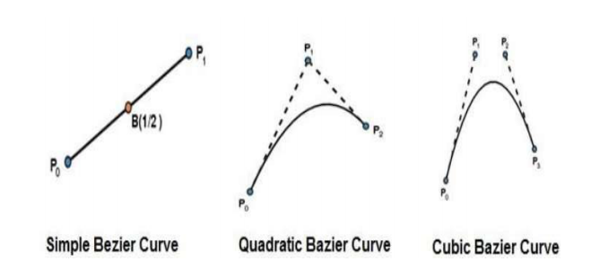
Bezier Curves
Degree of defining polynomial depends on the number of control points. If two control points means degree 1 , 3 control points means degree 2

Slide 80
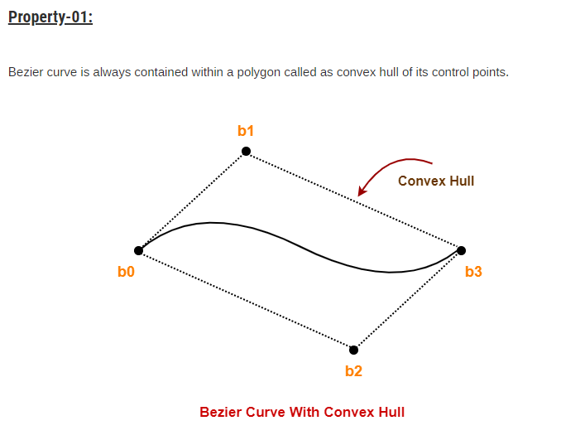
Properties of Bezier Curves

Slide 81
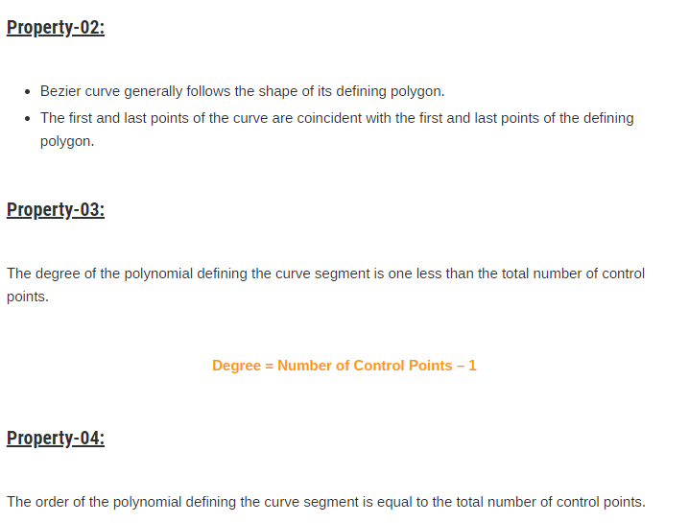
Properties of Bezier Curves

Slide 82
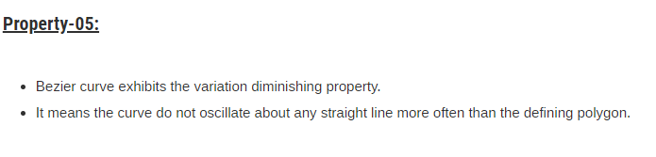
Properties of Bezier Curves

Slide 83
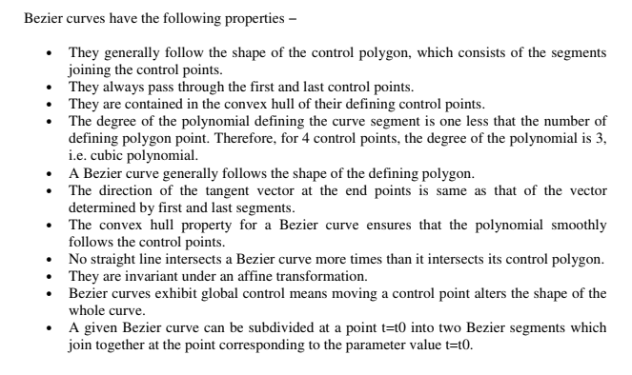
Properties of Bezier Curves

Slide 84
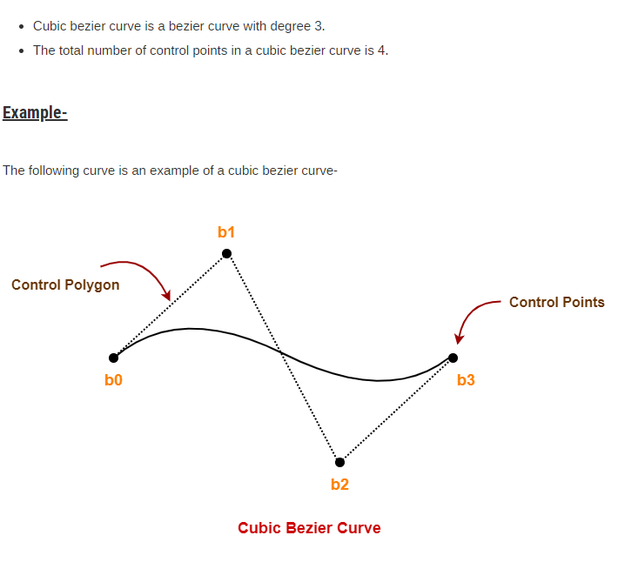
Cubic Bazier curve

Slide 85

Cubic Bazier curve

Slide 86


Slide 87


Slide 88


Slide 89

Example

Slide 90


Slide 91


Slide 92


Slide 93


Slide 94


Slide 95
B-Spline Curves
The Bezier-curve produced by the Bernstein basis function has limited flexibility.
• First, the number of specified polygon vertices fixes the order of the resulting polynomial which defines the curve.
The second limiting characteristic is that the value of the blending function is nonzero for
all parameter values over the entire curve.

Slide 96

B-Spline Curves

Slide 97

B-Spline Curves

Slide 98
Properties of B-spline Curve
B-spline curves have the following properties −
• The sum of the B-spline basis functions for any parameter value is 1.
• Each basis function is positive or zero for all parameter values.
Each basis function has precisely one maximum value, except for k=1.
• The maximum order of the curve is equal to the number of vertices of defining polygon.
• The degree of B-spline polynomial is independent on the number of vertices of defining
polygon.
• B-spline allows the local control over the curve surface because each vertex affects the
shape of a curve only over a range of parameter values where its associated basis function
is nonzero.
• The curve exhibits the variation diminishing property.
• The curve generally follows the shape of defining polygon.
• Any affine transformation can be applied to the curve by applying it to the vertices of
defining polygon.
• The curve line within the convex hull of its defining polygon.

Slide 99
https://richardfuhr.neocities.org/BusyBCurves.html
https://www.youtube.com/watch?v=-aiErrvLRfE

Slide 100
Shape description requirements
The following are some of the important properties that are used to design the curves. The similar properties can also be used for designing the surfaces as surfaces are made up of curves.
(a)Control Points:
The shape of the curve can be controlled easily with the help of a set of control points, means the points will be marked first and curve will be drawn that intersects each of these points one by one in a particular sequence. The more number of control points makes the curve smoother. The following figure shows the curve with control points.

Slide 101


Slide 102
(b)Multiple values:
In general any curve is not a graph of single valued function of a coordinate, irrespective the choice of coordinate system. Generally single valued functions of a coordinate make the curves or graphs that are dependent on axis. The following figure shows multi valued curve with respect to all coordinate systems.

Slide 103


Slide 104
(c)Axis Independence:
The shape of an object should not change when the control points are measured in different coordinate systems, that means when an object is rotated to certain angle in any direction (clockwise or anti-clockwise) the shape of the curve should not be affected.

Slide 105
(d)Global or local control:
The control points of a curve must be controlled globally from any function of the same program or it can also be controlled locally by the particular function used to design that curve by calculating the desired control points.

Slide 106
(e)Variation-diminishing property:
Some of the mathematical functions may diminish the curve at particular points and in some other points it may amplify the points. This leads to certain problems for curves appearance at the time of animations, (just as a vehicle looks curved when it is taking turn). This effect must be avoided with the selection of proper mathematical equations with multiple valued functions.

Slide 107
(f) Versatility:
The functions that define the shape of the curve should not be limited to only few varieties of shapes, instead they must provide vide varieties for the designers to make the curves according to their interest.

Slide 108
(g)Order of continuity:
For any complex shapes or curves or surfaces it is essential to maintain continuity in calculating control points. When we are not maintaining the proper continuity of control points it makes a mesh while marking the curve and the complex object.

Slide 109
Three dimensional concepts
Parallel Projection
Perspective Projection
Depth Cueing
Visible Line and Surface Identification
Surface Rendering
Exploded and Cutaway Views
Three-Dimensional and Stereoscopic Views

Slide 110

Parallel Projection

Slide 111
Parallel Projection
In this method a view plane is used. z co-ordinate is discarded. The 3D view is constructed by extending lines from each vertex on the object until they intersect the view plane. Then connect the projected vertices by line segments which correspond to connections on the original object.

Slide 112
Perspective Projection
Here the lines of projection are not parallel. Instead, they all converge at a single point called the `center of projection' or `projection reference point'. The object positions are transformed to the view plane along these converged projection lines. In this method, Objects farther from the viewing position appear smaller.

Slide 113

Perspective Projection

Slide 114
Depth Cueing
Depth information is added. The depth of an object can be represented by the intensity of the image. The parts of the objects closest to the viewing position are displayed with the highest intensities. Objects farther away are displayed with decreasing intensities.

Slide 115

Depth Cueing

Slide 116
Visible Line and Surface Identification
Visible lines are displayed in different color. Invisible lines either displayed in dashed lines or not at all displayed. Removing invisible lines also removes the info about the backside of the object. Surface rendering can be applied for the visible surfaces, so that hidden surfaces will become obscured.

Slide 117

Visible Line and Surface Identification

Slide 118

Surface Rendering

Slide 119

Exploded and Cutaway Views

Slide 120
FRACTALS
Fractals are very complex pictures generated by a computer from a single formula.
They are created using iterations. This means one formula is repeated with slightly different values over and over again, taking into account the results from the previous iteration.

Slide 121
FRACTALS
Fractals are used in many areas such as −
Astronomy − For analyzing galaxies, rings of Saturn, etc.
Biology/Chemistry − For depicting bacteria cultures, Chemical reactions, human anatomy, molecules, plants,
Others − For depicting clouds, coastline and borderlines, data compression, diffusion, economy, fractal art, fractal music, landscapes, special effect, etc.

Slide 122

FRACTALS

Slide 123
Three common techniques for generating fractals
Iterated function systems
These have a fixed geometric replacement rule. Cantor set, Sierpinski carpet, Sierpinski gasket, Peano curve, Koch snowflake, Harter-Heighway dragon curve, T-Square, Menger sponge, are some examples of such fractals.

Slide 124
Escape-time fractals
Fractals defined by a recurrence relation at each point in a space (such as the complex plane). Examples of this type are the Mandelbrot set, the Burning Ship fractal and the Lyapunov fractal.

Slide 125
Random fractals
Generated by stochastic rather than deterministic processes, for example, fractal landscapes, Lévy flight and the Brownian tree. The latter yields so-called mass- or dendritic fractals, for example, Diffusion Limited Aggregation or Reaction Limited Aggregation clusters.

Slide 126
Fractals can also be classified according to their self-similarity.
Exact self-similarity
This is the strongest type of self-similarity; the fractal appears identical at different scales. Fractals defined by iterated function systems often display exact self-similarity.

Slide 127
Quasi-self-similarity
This is a loose form of self-similarity; the fractal appears approximately (but not exactly) identical at different scales. Quasi-self-similar fractals contain small copies of the entire fractal in distorted and degenerate forms. Fractals defined by recurrence relations are usually quasi-self-similar but not exactly self-similar.

Slide 128
Statistical self-similarity
This is the weakest type of self-similarity; the fractal has numerical or statistical measures which are preserved across scales. Most reasonable definitions of "fractal" trivially imply some form of statistical self-similarity. (Fractal dimension itself is a numerical measure which is preserved across scales.) Random fractals are examples of fractals which are statistically self-similar, but neither exactly nor quasi-self-similar.

Slide 129

Generation of Fractals
Fractals can be generated by repeating the same shape over and over again as shown in the following figure. In figure (a) shows an equilateral triangle. In figure (b), we can see that the triangle is repeated to create a star-like shape. In figure (c), we can see that the star shape in figure (b) is repeated again and again to create a new shape.

Slide 130
Geometric Fractals
Geometric fractals deal with shapes found in nature that have non-integer or fractal dimensions. To geometrically construct a deterministic (nonrandom) self-similar fractal, we start with a given geometric shape, called the initiator. Subparts of the initiator are then replaced with a pattern, called the generator.

Slide 131

Geometric Fractals

Slide 132

Geometric Fractals

Slide 133

Strictly Self-Similar Fractals

Slide 134

Strictly Self-Similar Fractals

Slide 135
Cantor Set
It is the foundation for many important fractals.
Begin with the unit interval [0,1], which is represented below as a line segment (stage 0). Delete the middle third, which is the open interval (1/3, 2/3), leaving the two closed subintervals [0, 1/3] and [2/3, 1]. Now repeat this process on each of these subintervals, leaving 4 subintervals, and continue repeating this process on each new set of smaller subintervals forever

Slide 136

Cantor Set

Slide 137

Koch Curve
an example of a curve that is continuous but nowhere differentiable.

Slide 138

The Peano Curve and Fractal Curves
An example of curve that completely cover a two-dimensional region of the plane.
based on replacement rules.

Slide 139

Replacement rules

Slide 140


